Slide 1



Trusted sla-guided data integration on multi-cloud environments
Daniel Aguiar da Silva Carvalho, Magellan, IAE, Université Jean Moulin Lyon3
Advisors
Chirine Ghedira Guegan, LIRIS, UMR5205, IAE, Université Jean Moulin Lyon3, France
Genoveva Vargas-Solar, CNRS, LIG-LAFMIA, France
Nadia Bennani, LIRIS, UMR5205, INSA-Lyon, - France

Slide 2
Daniel Aguiar da Silva Carvalho
Current position
2014-2017
3rd year of PhD
InfoMaths doctoral school, University Lyon 1, Magellan Lab, Lyon3
Projects & Internships
Project Multi-cloud, ARC-6
Education
2013
Master in Systems and Computing
Federal University of Rio Grande do Norte, Brazil
Projects & Internships
4-months Internship
UDELAR, Uruguay (CAPES)
National Research Network, Brazil
2011
XXX degree System analysis
Federal Institute of Rio Grande do Norte, Brazil

Slide 3
Research context: data integration
Query
Result
Data integration: the teenage years. Halevy, A., Rajaraman, A., & Ordille, J. (VLDB 2006, September)
Schema integration: Past, present, and future (Ram, S., & Ramesh, V. 1999)
Global schema
Mediator
Query rewriting
Data integration architectures:
Multi-databases, federations, DW, …
(Domenig & Dittrich 1999 Sigmod Record)
MiniCon algorithm for query rewriting (Pottinger and Halevy, 2001)
Exported schemata
Data
source A
Data
source B
Data
source C
Heterogeneous data sources known in advance

Slide 4
Research context: data integration
Services lookup and matching
[1] Paolucci, M., Kawamura, T., Payne, T. R., & Sycara, K. (2002, June). Semantic matching of web services capabilities. In International Semantic Web Conference (pp. 333-347). Springer Berlin Heidelberg.
[2} Bramantoro, A., Krishnaswamy, S., & Indrawan, M. (2005, November). A semantic distance measure for matching web services. In International Conference on Web Information Systems Engineering (pp. 217-226). Springer Berlin Heidelberg.
[3} APA Maximilien, E. M., & Singh, M. P. (2004, November). Toward autonomic web services trust and selection. In Proceedings of the 2nd international conference on Service oriented computing (pp. 212-221). ACM.
Query
Result
Mediator
Query rewriting techniques adapted to service composition
Exported API
[4] Barhamgi, M., Benslimane, D., and Medjahed, B. (2010). A query rewriting approach for web service composition. IEEE T. Services Computing, 3(3):206–222.
[5] da Costa, U. S., Alves, M. H. F., Musicante, M. A., and Robert, S. (2013). Automatic refinement of service compositions. In Daniel, F., Dolog, P., and Li, Q., editors, ICWE, volume 7977 of Lecture Notes in Computer Science, pages 400–407. Springer.
[6] Zhao, W., Liu, C., and Chen, J. (2011). Automatic composition of information-providing web services based on query rewriting. Science China Information Sciences, pages 1–17.
. . .
Distributed data services

Slide 5
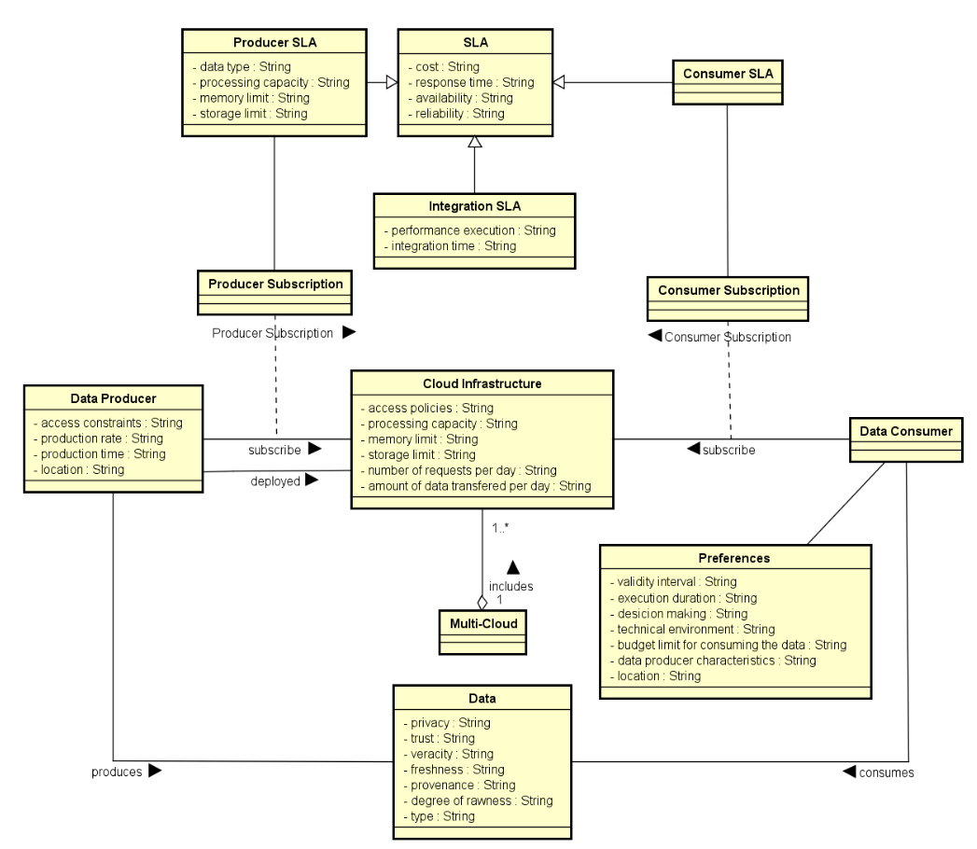
¹ D. A. S. Carvalho, P. A. S. Neto, C. Ghedira, G. Vargas-Solar, N. Bennani. Towards Quality Guided Data Integration on Multi-Cloud Settings. 14th international conference on service oriented computing (ICSOC), Oct 2016, Banff, Alberta, Canada.
Notes:
Based on the experimental validation, we can show you the Rhones’ profile
We can see the complexity of the different phases. As in the other algorithms, the most expensive step is the combination. It depends on the size of the query and the number of concrete service that could be mapped to the query.
The results of our experimental validation are illustrated by these two charts.
The performance increased by reducing the number of rewriting solutions and integration execution time. As we can see in the chart on the left.
Rewritring solutions quality enhanced and the integration economic cost is reduced once only rewriting that satisfies the user preferences are produced. As we can see in the chart on the right.
Click

Slide 6



Research context: limitations
Mainly associated to performance (availability and response time) and privacy.
Query with requirements
Mediador
The service selection and composition are not done considering SLAs and data properties.
Results
Data providers are not allowed to express properties of the data they are delivering.
Current solutions do not consider that data providers can be out of resources according to their cloud subscriptions.
S1
S7
S2
S5
S6
S8
S9
S1
S3
S4
Data Provider A
Data Provider C
Data Provider B
Data Provider C
Data Provider A
Data Provider D
SLA
SLA
SLA
SLA
SLA
SLA
Cloud Provider 1
Cloud Provider 2
Cloud Provider 3
Current SLAs are insterested only in performance aspects and business rules.
22/03/2017
6

Slide 7
SLA guided data integration
Query with requirements
Store results
DIaaS
Results
Query History
SLA_{I}
SLA_{s}
SLA_{s}
SLA_{s}
SLA_{s}
SLA_{s}
SLA_{s}
SLA_{s}
SLA_{s}
SLA_{s}
SLA_{s}
S1
S7
S2
S5
S6
S8
S9
S1
S3
S4
Data Provider A
Data Provider C
Data Provider B
Data Provider C
Data Provider A
Data Provider D
SLA_{c}
SLA_{c}
SLA_{c}
SLA_{c}
SLA_{c}
SLA_{c}
Cloud Provider 1
Cloud Provider 2
Cloud Provider 3

Slide 8
SLA guided data integration
Q (a; b):= A1 (a; c), A2 (c; b) {availability > 96%, response time < 2s, total cost < 1$}
Query with requirements
Store results
DIaaS
H := < s, t, A, R, C, w >
Results
Query History
S2 (x; y):= A2 (x; y)
{availability > 97%, response time < 2s, price per call = 0.1$}
SLA_{I}
S1 (x; y):= A1 (x; y)
{availability > 98%, response time < 1s, price per call = 0.1$}
S3 (x; y):= A1 (x; s), A2 (s; y)
{availability > 98%, response time < 2s, price per call = 0.3$}
SLA_{s}
SLA_{s}
SLA_{s}
SLA_{s}
SLA_{s}
SLA_{s}
SLA_{s}
SLA_{s}
SLA_{s}
SLA_{s}
S1
S7
S2
S5
S6
S8
S9
S1
S3
S4
Data Provider A
Data Provider C
Data Provider B
Data Provider C
Data Provider A
Data Provider D
SLA_{c}
SLA_{c}
SLA_{c}
SLA_{c}
SLA_{c}
SLA_{c}
Cloud Provider 1
Cloud Provider 2
Cloud Provider 3

Slide 9
Aspects to consider & objective
Which services should I select ? Are the requirements being respected?
How to be sure that all SLAs are being respected?
How to integrate different SLAs associated to services involved with user’s requirements?
How results can be reused for a next query?
Objective
Propose a data integration approach in a multi-cloud environment guided by user requirements and SLA exported by different clouds

Slide 10
Approach: data integration workflow
Reusing previous
results
Search for previous queries
With respect to our query taxonomy and reusability approach
Storing results
- With respect to quality requirements
- According to our query taxonomy
Processing the complete rewriting
Storing results in our query history
Service-based query rewriting according to SLA

Slide 11
Results and contribution
Data Integration Metamodel
Building the corpus of State of the Art using the systematic mapping methodoloty¹
Describing the challenges and problems of SLA guided data integration
Rhone Query
Rewriting Algorithm
Rewriting approach taking into consideration user requirements and Service Level Agreements
Query Taxonomy
Indentification and formalization of queries to be treated by our approach
Query Rewriting Reuse Strategies
Formalization of a reusability approach for reducing the query rewriting overhead
¹ D. A. S. Carvalho, P. A. Souza Neto, G. Vargas-Solar, N. Bennani, C. Ghedira, Can Data Integration Quality be Enhanced on Multi-cloud using SLA?, In 26th Int. Conf. on Database and Expert Systems Applications, Spain, 2015.

Slide 12
Rhone query rewriting algorithm¹
Considers user integration preferences and services’ quality aspects expressed in SLAs.
Selecting candidate concrete services
Creating candidate service descriptions (CSD)
Combinig CSDs
Producing rewritings
¹ D. A. S. Carvalho, P. A. S. Neto, C. Ghedira, G. Vargas-Solar, N. Bennani. Rhone: a quality-based query rewriting algorithm for data integration. East-European Conference on Advances in Databases and Information Systems, Aug 2016, Prague, France. ADBIS East-European Conference on Advances in Databases and Information Systems, 2016.

Slide 13
Selecting services & Compositions
A method for service and composition selection:
We have started working on an heuristic to rank data services and compositions based on SLA measures concerning service properties (percentage of availability, response time, throughput and others) and data properties (data type, freshness, veracity, provenance and others).
Figure where formulae can appear
$\frac{Mactual − Mmin}{Mmax − Mmin}$ (if M is a positive measure)
$$Smeasure\left(M\right)=$$
$\frac{Mmax − Mactual}{Mmax − Mmin}$ (if M is a negative measure)
$$Sservice\left(DS\right)=\frac{w1 ∗ S\left(M1\right)+ w2 ∗ S\left(M2\right)+…+ wn ∗ S\left(Mn\right)}{w1+ w2 +…+ wn}$$
Notes:
Based on the experimental validation, we can show you the Rhones’ profile
We can see the complexity of the different phases. As in the other algorithms, the most expensive step is the combination. It depends on the size of the query and the number of concrete service that could be mapped to the query.
The results of our experimental validation are illustrated by these two charts.
The performance increased by reducing the number of rewriting solutions and integration execution time. As we can see in the chart on the left.
Rewritring solutions quality enhanced and the integration economic cost is reduced once only rewriting that satisfies the user preferences are produced. As we can see in the chart on the right.
Click

Slide 14
Selecting services & Compositions
...
S1
S2
S1
S2
S1
S8
S1
S12
S1
S21
S3
S8
$\frac{Mactual − Mmin}{Mmax − Mmin}$ (if M is a positive measure)
S4
S12
$$Smeasure\left(M\right)=$$
S4
S12
$\frac{Mmax − Mactual}{Mmax − Mmin}$ (if M is a negative measure)
Identify that the best option is...
S5
S21
...
...
$$Sservice\left(DS\right)=\frac{w1 ∗ S\left(M1\right)+ w2 ∗ S\left(M2\right)+…+ wn ∗ S\left(Mn\right)}{w1+ w2 +…+ wn}$$

Slide 15
Reusing queries
new query
Q₁ := < s, t, A, R, C, w >
Q₂ := < s?, t?, A, R, C?, w? >
Supposing that Q₂ is a subset of Q₁:
Q₃ := < s, t, A, R, C, w >
This means Q₂.A ⊂ Q₁.A and Q₂.R ⊲ Q₁.R
Q₄ := < s, t, A, R, C, w >
Q₅ := < s, t, A, R, C, w >
reuse results
Q₂.C ⟵ {c_{i}} st. {⩝c_{i} ∊ Q₁.C, ∄ds ∊ c_{i} | ds is offline}
Q₆ := < s, t, A, R, C, w >
Q₂.C ⟵ project(Q₂)
Q₇ := < s, t, A, R, C, w >
Q₂.S ⟵ {ds_{i}} st. {⩝ds_{i} ∊ Q₁.S, ∃c ∊ Q₂.C | ds_{i} ∊ c}
Q₈ := < s, t, A, R, C, w >
Q₂ := < s, t, A, R, C, w >
Q₂.w ⟵ max (Q₂.C)
Q₉ := < s, t, A, R, C, w >
...
stored
Query History
Rhone was adapted to be in accordance history.

Slide 16

Reusing queries
Figure where formulae can appear
A method for reusing queries:
Based on the proposed query taxonomy, we have designed and formalized a reusability approach which allows to reuse data services and compositions from previous integration in order to profit from them.
Query type:
Given two queries Q₁ and Q₂, Q₂ is a subset of Q₁ if:
For this type, we are able to completely reuse Q₁ :
Notes:
Based on the experimental validation, we can show you the Rhones’ profile
We can see the complexity of the different phases. As in the other algorithms, the most expensive step is the combination. It depends on the size of the query and the number of concrete service that could be mapped to the query.
The results of our experimental validation are illustrated by these two charts.
The performance increased by reducing the number of rewriting solutions and integration execution time. As we can see in the chart on the left.
Rewritring solutions quality enhanced and the integration economic cost is reduced once only rewriting that satisfies the user preferences are produced. As we can see in the chart on the right.
Click

Slide 17
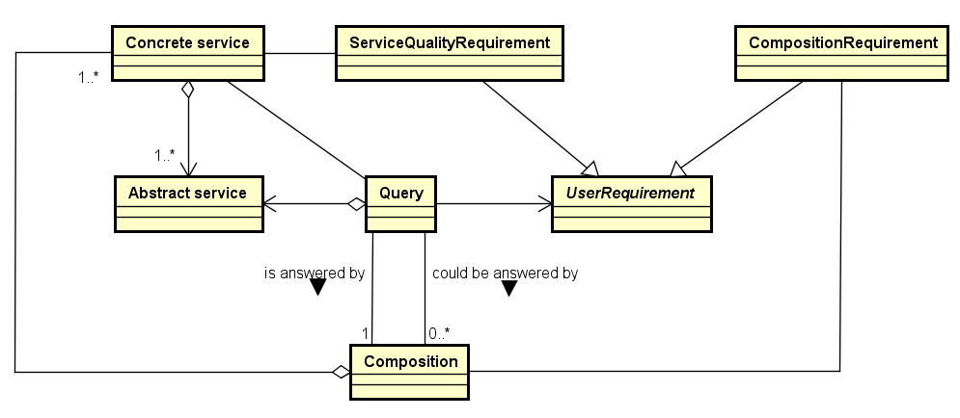
Query log
Query history data model and implementation:
Design and implementation of the query history data model, which includes queries, abstract services, data services and compositions
Rhone algorithm was adapted to be in accordance with the model below:
Notes:
Based on the experimental validation, we can show you the Rhones’ profile
We can see the complexity of the different phases. As in the other algorithms, the most expensive step is the combination. It depends on the size of the query and the number of concrete service that could be mapped to the query.
The results of our experimental validation are illustrated by these two charts.
The performance increased by reducing the number of rewriting solutions and integration execution time. As we can see in the chart on the left.
Rewritring solutions quality enhanced and the integration economic cost is reduced once only rewriting that satisfies the user preferences are produced. As we can see in the chart on the right.
Click

Slide 18

Query taxonomy
Definition and formalization of a taxonomy of queries:
We have defined and formalized a set of possible relations between queries which differ in terms of abstract services, service properties and data properties.
For example, a query is defined as a tuple:
where: s is status; t is the timestap; A is a set of abstract services defining the query; R is a set of user preferences; S is a set of data services; C is a set of compositions; and w is the composition that were selected to answer the query Q.
Query type:
Given two queries Q₁ and Q₂, Q₂ is a subset of Q₁ if:
Figure where formulae can appear
Notes:
Based on the experimental validation, we can show you the Rhones’ profile
We can see the complexity of the different phases. As in the other algorithms, the most expensive step is the combination. It depends on the size of the query and the number of concrete service that could be mapped to the query.
The results of our experimental validation are illustrated by these two charts.
The performance increased by reducing the number of rewriting solutions and integration execution time. As we can see in the chart on the left.
Rewritring solutions quality enhanced and the integration economic cost is reduced once only rewriting that satisfies the user preferences are produced. As we can see in the chart on the right.
Click

Slide 19
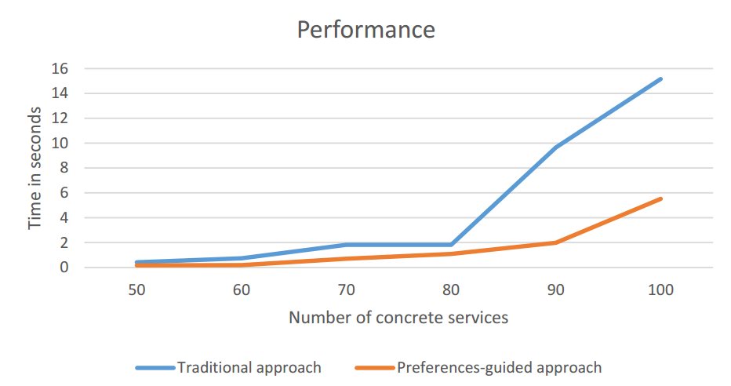
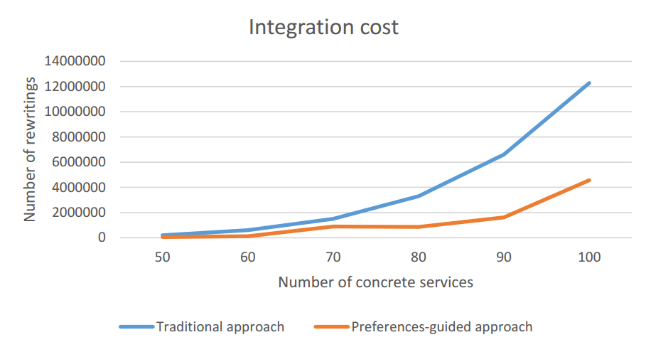
Implementation & experiments
Cloud simulation including 100 services
Expensive while combining services: O(n^{k})
Performance increased reducing the number of rewriting solutions and integration execution time
Integration economic cost potentially reduced
Notes:
Based on the experimental validation, we can show you the Rhones’ profile
We can see the complexity of the different phases. As in the other algorithms, the most expensive step is the combination. It depends on the size of the query and the number of concrete service that could be mapped to the query.
The results of our experimental validation are illustrated by these two charts.
The performance increased by reducing the number of rewriting solutions and integration execution time. As we can see in the chart on the left.
Rewritring solutions quality enhanced and the integration economic cost is reduced once only rewriting that satisfies the user preferences are produced. As we can see in the chart on the right.
Click

Slide 20
Professional and scientific activities
2014.2 | 2015.1 | 2015.2 | 2016.1 | 2016.2 | 2017.1
French course
French course
French course
Courses
Workshop: Writing scientific papers
Magellan IS group
Magellan IS group
Magellan IS group
Presentations
LIRIS SOC team
Presentation ADBIS 2016
Poster ARC
Poster ARC
Thematic schools
Smart cities and Big Data
Publications
DEXA 2015
ADBIS 2016
AICCSA 2015
ICSOC 2016
Continuous work
with advisors
Weekly face to face meetings
Experimentation
Formalization of model & algorithms

Slide 21
Future work
Activities: | 02/17 | 03/17 | 04/17 | 05/17 | 06/17
Improving and correcting the query taxonomy and reusability approach formalization
Implementing and including in Rhone the reusability functions
Building the proof of concept to the approach
Writing a paper to ER 2017
Concluding the work concerning the heuristic for optimizing service selection and composition
Writing the final thesis document

Slide 22
Daniel Aguiar da Silva Carvalho, Magellan, IAE, Université Jean Moulin Lyon3
Advisors:
Chirine Ghedira Guegan, LIRIS, UMR5205, IAE, Université Jean Moulin Lyon3, France
Genoveva Vargas-Solar, CNRS, LIG-LAFMIA, France
Nadia Bennani, LIRIS, UMR5205, INSA-Lyon, France

Slide 23
Introduction
Daniel Aguiar da Silva Carvalho
Diplomas:
System analysis degree in the Federal Institute of Rio Grande do Norte, Brazil
Master degree in System and Computation in the Federal University of Rio Grande do Norte, Brazil
Internships and projects:
4-months Internship at UDELAR, Uruguay
National Research Network, Brazil
3rd year of PhD in the University of Lyon (Magellan Lab, Lyon3)

Slide 24
Agenda
Introduction
Research context
Results and contributions
Professional and scientific activities
Perspectives

Slide 25
Future work
Future works:
Implementing new algorithms to include reusability issues
Concluding the heuristic approach adapted to the context
Experiments: building a proof of concept to the approach
Notes:
Based on the experimental validation, we can show you the Rhones’ profile
We can see the complexity of the different phases. As in the other algorithms, the most expensive step is the combination. It depends on the size of the query and the number of concrete service that could be mapped to the query.
The results of our experimental validation are illustrated by these two charts.
The performance increased by reducing the number of rewriting solutions and integration execution time. As we can see in the chart on the left.
Rewritring solutions quality enhanced and the integration economic cost is reduced once only rewriting that satisfies the user preferences are produced. As we can see in the chart on the right.
Click

Slide 26
Professional and scientific activities
Day-to-day work:
Currently attached to InfoMaths doctoral school (Lyon1) and working in the Magellan Research Center (Lyon3)
Easy access to the advisors
Regular meetings
At least 1 meeting per week (face-to-face or in a conference call)
Technical and scientific discussions: formalization exercises and experiment environment configuration
The objective is to define next activities
Notes:
Based on the experimental validation, we can show you the Rhones’ profile
We can see the complexity of the different phases. As in the other algorithms, the most expensive step is the combination. It depends on the size of the query and the number of concrete service that could be mapped to the query.
The results of our experimental validation are illustrated by these two charts.
The performance increased by reducing the number of rewriting solutions and integration execution time. As we can see in the chart on the left.
Rewritring solutions quality enhanced and the integration economic cost is reduced once only rewriting that satisfies the user preferences are produced. As we can see in the chart on the right.
Click

Slide 27
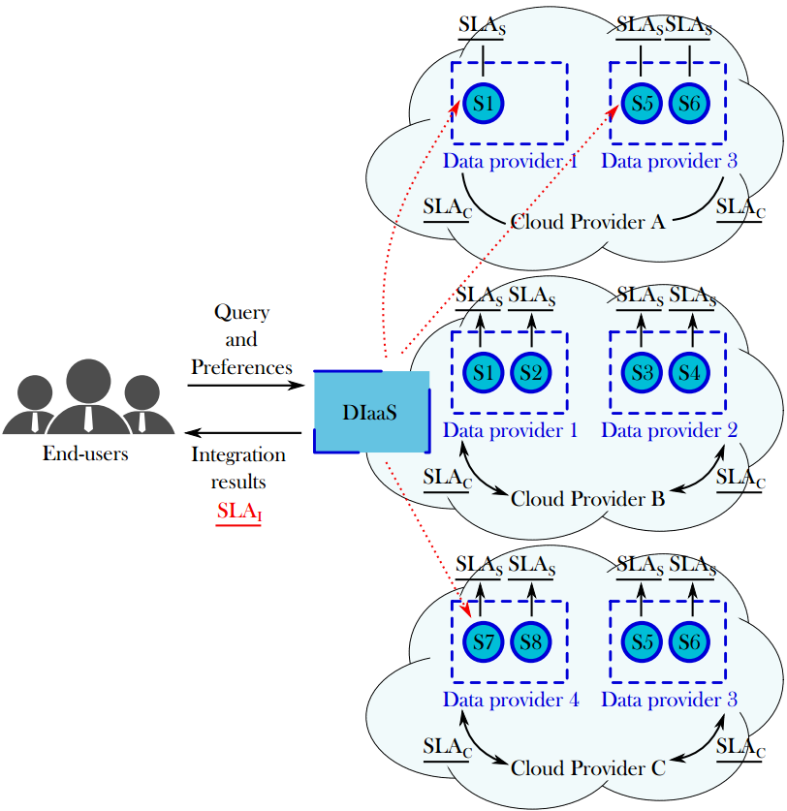
Target scenario: Challenges
Which services should I select ? Are the requirements being respected?
How to be sure that all SLAs are being respected?
How to integrate different SLAs associated to services involved with user’s requirements?
How results can be reused for a next query?
Objective
Propose a data integration approach in a multi-cloud environment guided by user requirements and SLA exported by different clouds

Slide 28
Approach
Addresses data integration considering
data quality (freshness, provenance, cost, availability) properties
service level agreements (SLA)
Hypothesis:
Data can be retrieved from several data providers (i.e., services) with different quality properties
The data integration process is totally or partially externalized on different clouds that provide necessary resources under different conditions (SLA)
Figure showing the approach including: services externalized on clouds, SLA’s, Query with user preferences, data integration guided by SLA

Slide 29
Results and contributions
SLA Derivation
Query Rewriting
# SLA guided integration
Search for previous queries
Process the complete rewriting
Query Evaluation
Needs to be consistent with what you enumerate next: rewritting with rhone, reuse
# Rewriting guided by SLA measures
Reusing results
Process rewriting
# Store the results
# SLA guided query optmization
# Execution

Slide 30
Data integration metamodel
Data integration metamodel¹ and SLA schemas:
Design of a metamodel for data integration
Design of a cloud SLA (that is an agreement between a data service and a cloud provider) and a service SLA (that is a new kind of agreement defined by data services exposing the properties of the data they provide)
Figure of the meta model including SLA (simplified version)
¹ D. A. S. Carvalho, P. A. S. Neto, C. Ghedira, G. Vargas-Solar, N. Bennani. Towards Quality Guided Data Integration on Multi-Cloud Settings. 14th international conference on service oriented computing (ICSOC), Oct 2016, Banff, Alberta, Canada.
Notes:
Based on the experimental validation, we can show you the Rhones’ profile
We can see the complexity of the different phases. As in the other algorithms, the most expensive step is the combination. It depends on the size of the query and the number of concrete service that could be mapped to the query.
The results of our experimental validation are illustrated by these two charts.
The performance increased by reducing the number of rewriting solutions and integration execution time. As we can see in the chart on the left.
Rewritring solutions quality enhanced and the integration economic cost is reduced once only rewriting that satisfies the user preferences are produced. As we can see in the chart on the right.
Click

